Slide 1

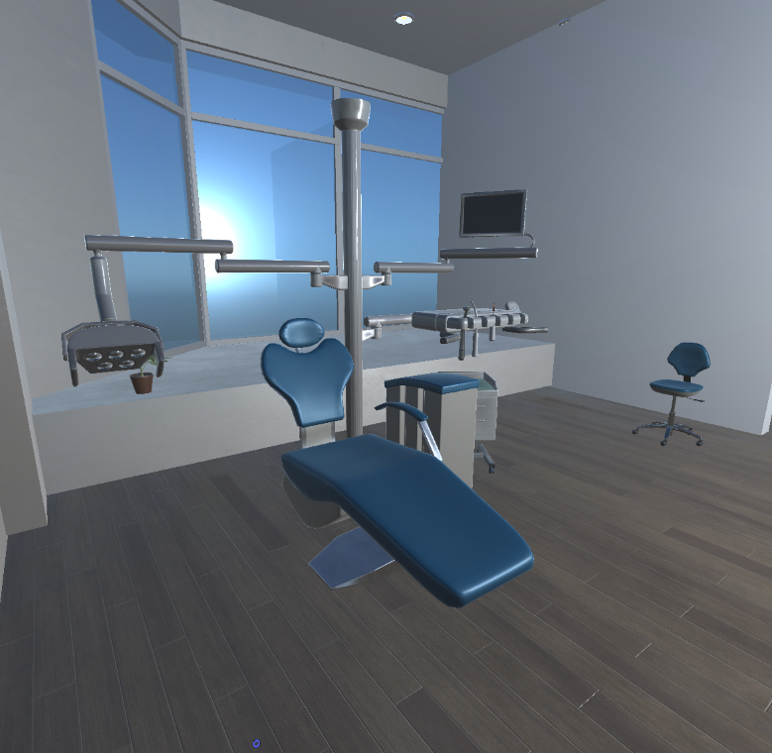
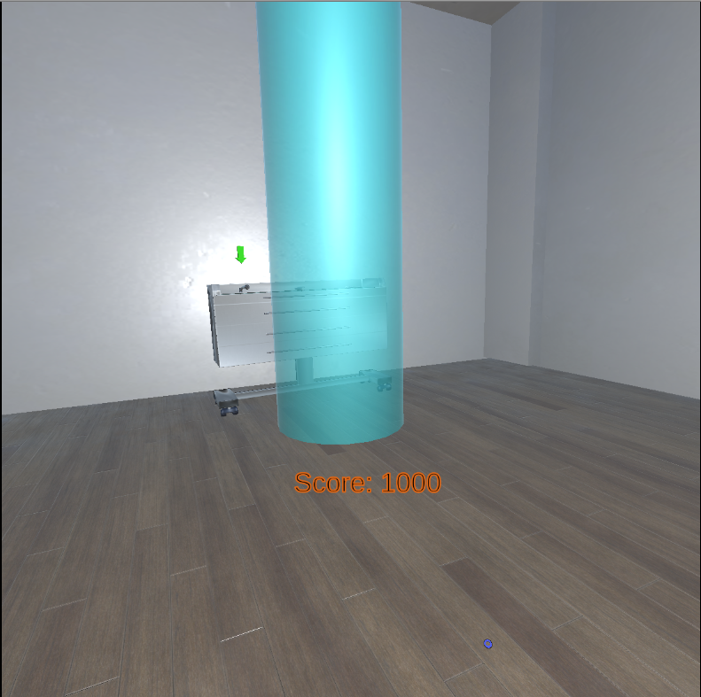
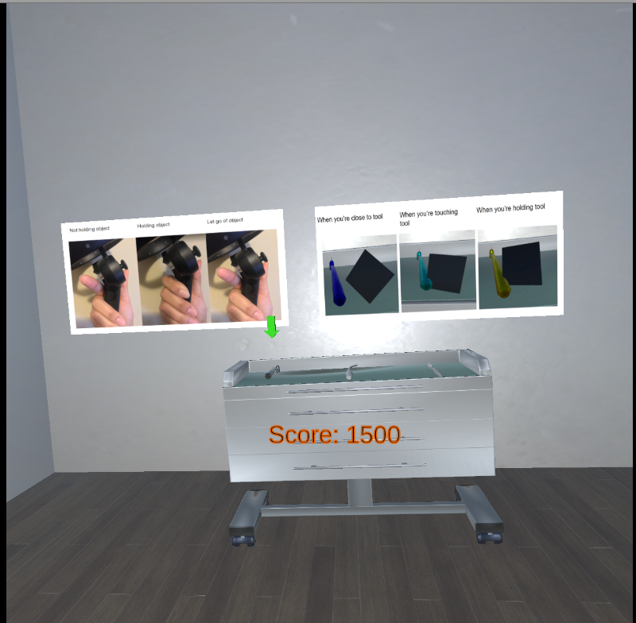
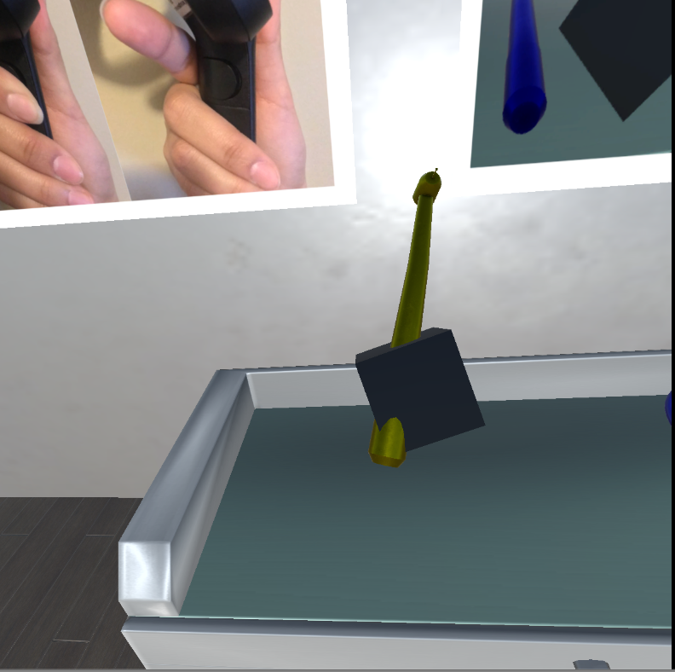
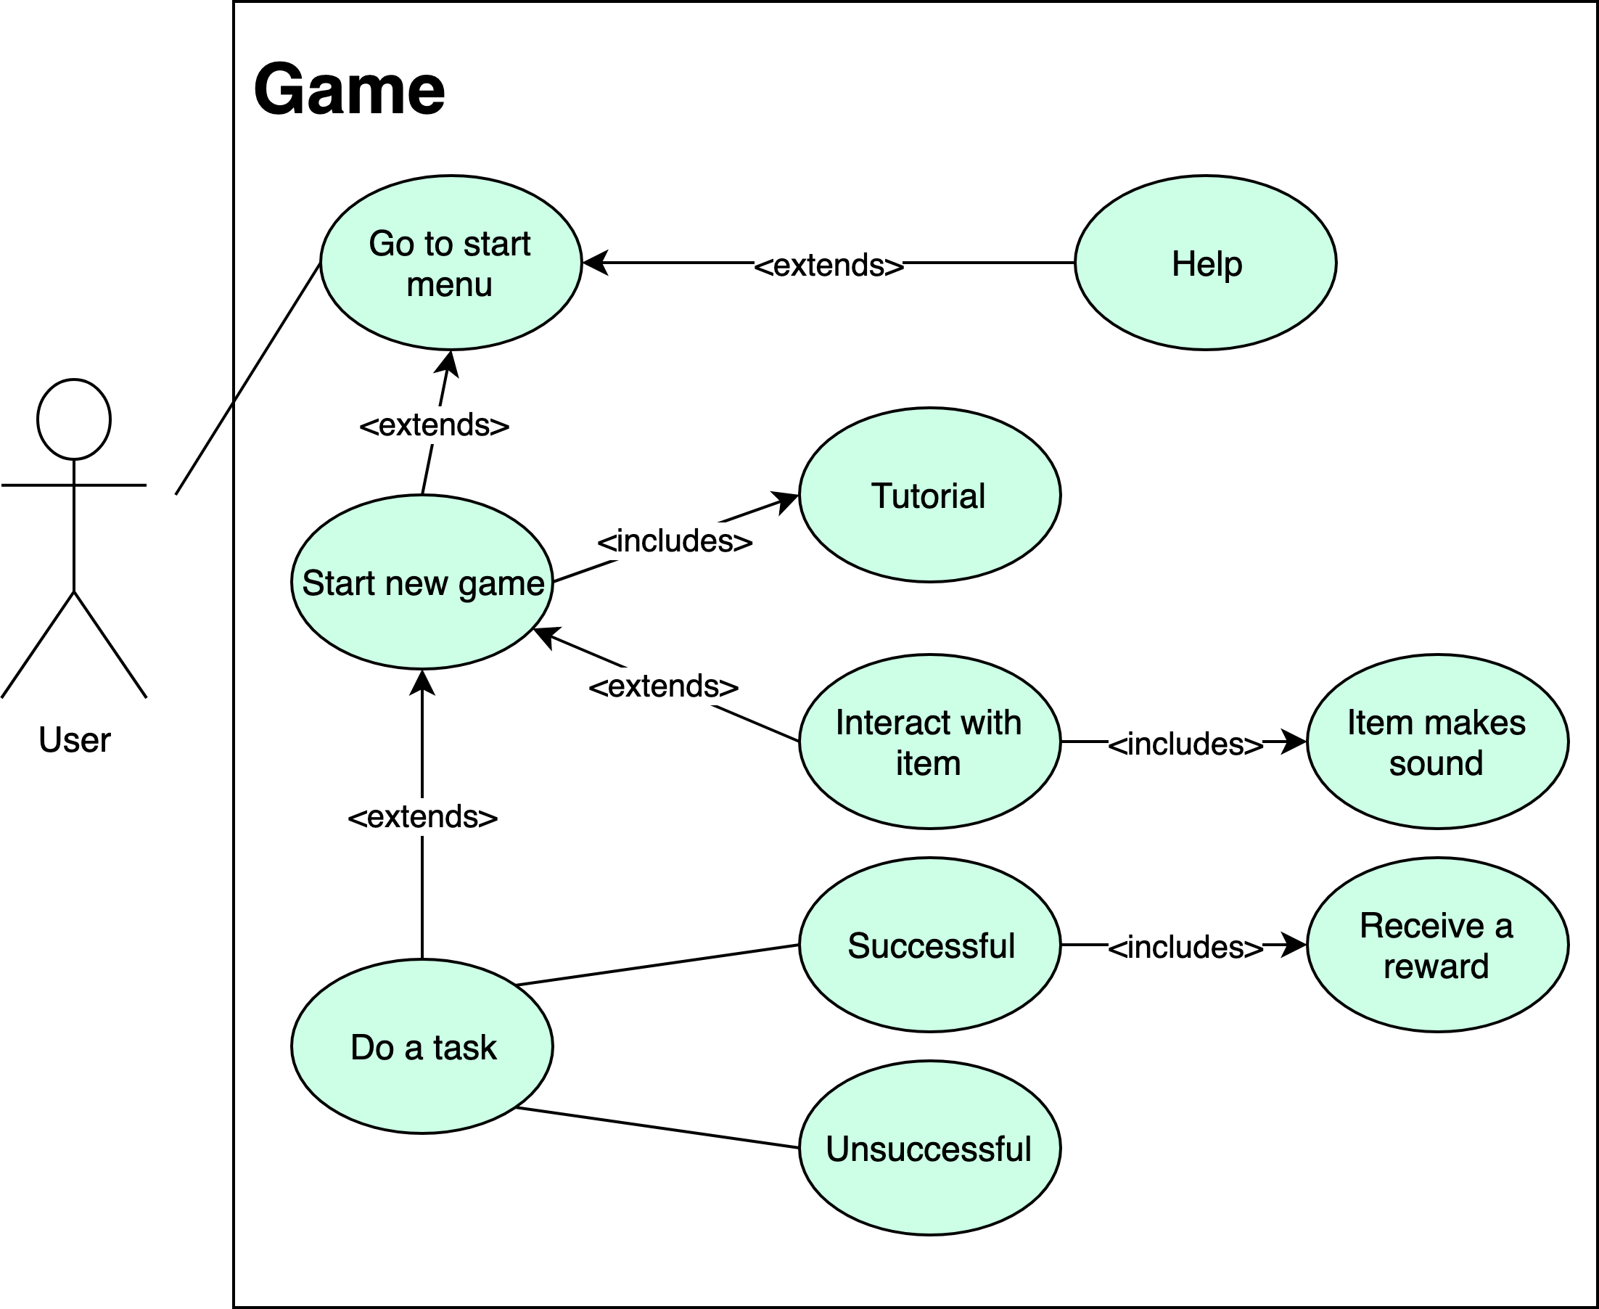
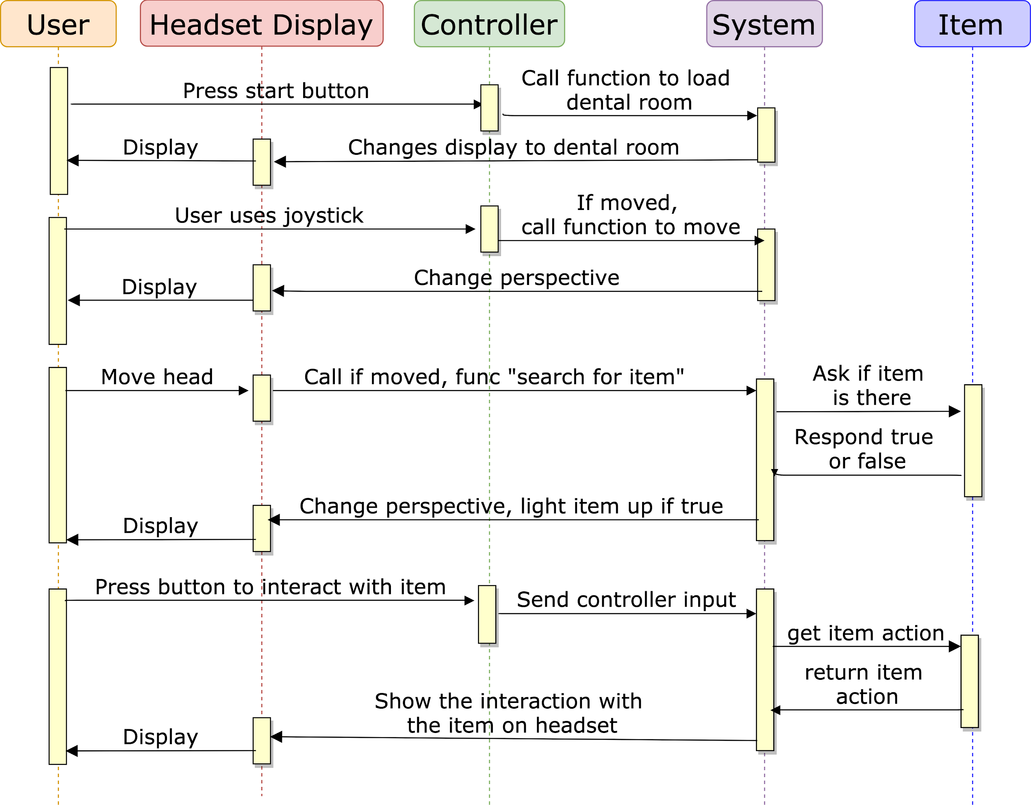
Day At The Dentist
Students: Khalil Crawford, Seungyoun Lee, Ritsuma Inaba, Jacob Sturgis
Faculty Mentor: Dr. David Chesney
In-Game-Photos
Background
Children with autism spectrum disorder (ASD) have a difficult time adjusting to different environments out of their regular routines. One such environment are dental offices, where children on average have appointments twice a year. Children with ASD spend a great amount of time fully adjusting to the dental office, significantly making appointments longer.
The environment and interactivity implemented in the project has been received well by our peers
Common Criticisms:
- Inadequate directions for user movement and task progression
- Unintuitive and uncomfortable input control
- Incorrect placement of dental furnishings according to the clients
Feedback
Dental Area
Targets Users Should Teleport To
Directions For Users
User Can Grab Objects
Client & Sponsor Objectives
Typical Use Case/Process Flow
Conclusion & Recommendations
Clients: Dr. Harneet Grewal and Dr. Angela Capuano
Faculty Mentor: Dr. D. Chesney
Requirements:
- Virtual reality simulation of a realistic dental office
- User can interact with dental tools and complete tasks
- Project is released during three sprints: the α, β, Ω
Goals:
- Make user fully situated in dental environment before checkup
The project has been successful at immersing the user in the dental environment, but many testers have had difficulty progressing through the tasks.
Goals For Next Release:
- Map buttons on controller to be more intuitive
- Create a tutorial to familiarize User to controls before they enter game
- Create a Dentist character to simulate a realistic check-up
Notes:
Original: The clients for this project, Dr. Harneet Grewal and Dr. Angela Capuano, requested a virtual reality simulation of a realistic dental office, where the user can interact with various dental tools and complete numerous tasks. The goal was to make the user fully situated in the dental environment before their checkup. Faculty mentor Dr. David Chesney set up the timeline for us to release the α, β, Ω products, as well as the release of documentation for the project.ori

